Slide 1
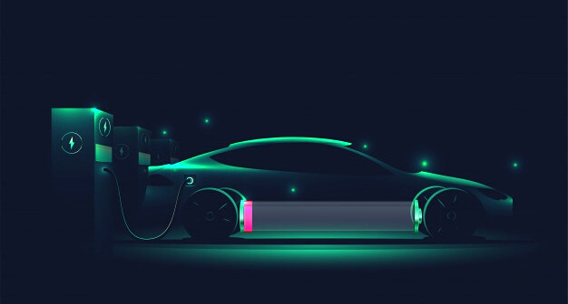
Optimal Placement of EV charging stations in context of Indian urban networks
Analysis and Approach in context of Indian cities

Slide 2
Problem Statement
Optimally deciding the location of EV charging stations in Indian cities taking into consideration various factors like charging facility investments, range anxiety, electrical network, road plans, etc.
Planning will involve :
1
2
3
EV charging station planning in distribution system and renewable resources integration
EV charging station planning in transportation network
Planning catering to uncertainities like driving behaviours,coordinated charging strategies,control systems etc.

Slide 3
MULTILEVEL- MULTI OBJECTIVE FUNCTION FORMULATION
Stage 1
Screening of the candidate locations for placement of charging station
Solution Approach
Stage 2:
Optimization
The second stage aims at finding the no. of charging stations that could be paced at a particular place

Slide 4
Stage 1
Screening of the candidate locations for placement of charging station
Parent nodes:congestion,VSF,Distance,reliability index
Child node: Candidate
Distance between node of the road network and nearest bus of the distribution network
Traffic intensity
Voltage stability index

Slide 5


Stage 2
Optimization
COST
01
02
WAITING TIME
Determines optimal capacity of the charging facilities and charging demand during a time interval

Slide 6
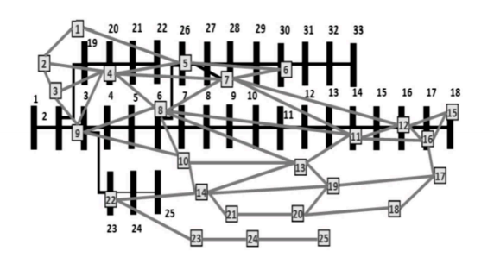
Test network
Candidate locations :
3,5,6,7,19,22,24
33 Bus distribution network+ 25 node transport network
Number of charging stations that could be placed at each location: 4

Slide 7
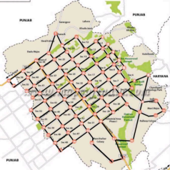
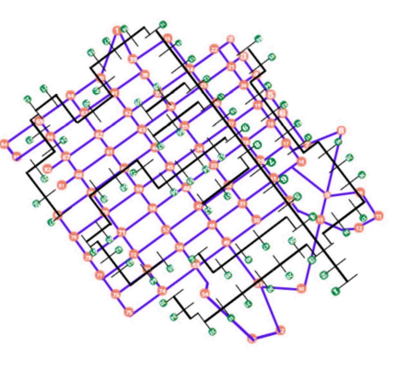
Case study
Candidate locations:
1,8,10,15,17,23,25,26,27,28,29,32,34,37,42,47,55,63,65,66
Urban Area+highways :Chandigarh city
Number of charging stations at each node: Atmost 7

Slide 8



Novelty
multi-stage multi-objective model : incorporates distribution system and transportation system constraints
1
Novel approach
2
Cost Effective
takes care of installation + incurred costs
Renewable resourcesintegration could be done
3
best solutions as per energy demands and satisfactory approach using renewable resources and hydrogen cell ev stations if needed

Slide 9
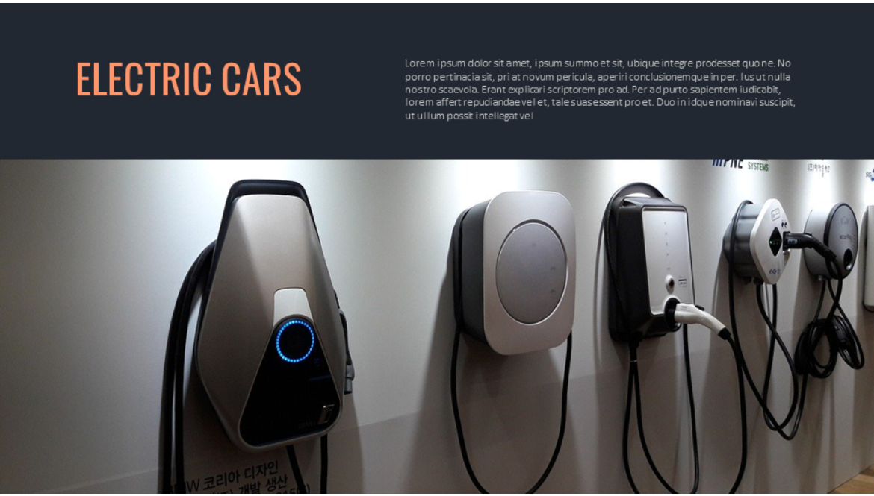




Development of models for intterconnected cities
DG installation along with microgrids
models considering market scenarios
FUTURE SCOPE
V2G integrations

Slide 10
Thankyou

